Slide 1
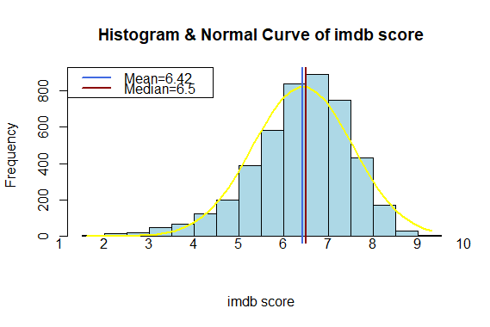
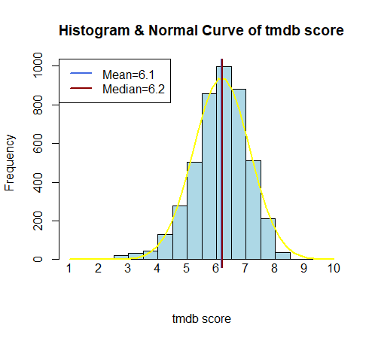
Min. 1st Qu. Median Mean 3rd Qu. Max. NA's
1.00 5.60 6.20 6.18 6.80 10.00 51
Min. 1st Qu. Median Mean 3rd Qu. Max.
1.600 5.800 6.500 6.425 7.200 9.300

Slide 2
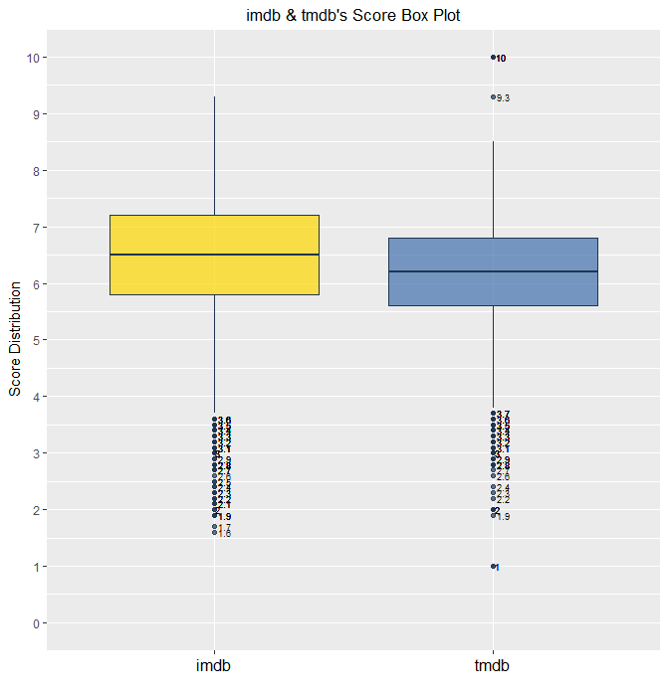
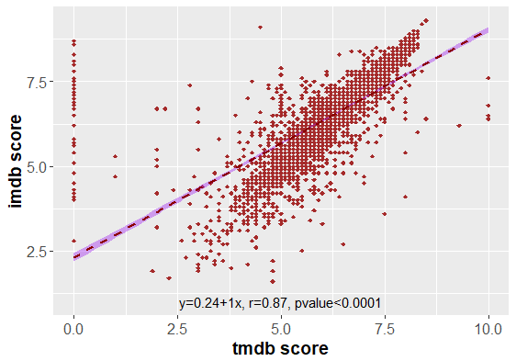

Slide 3
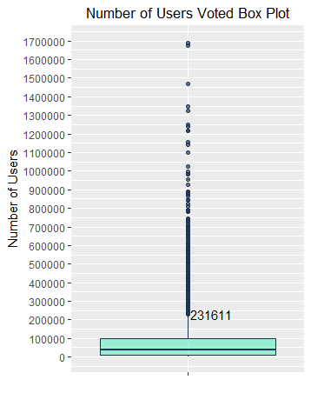
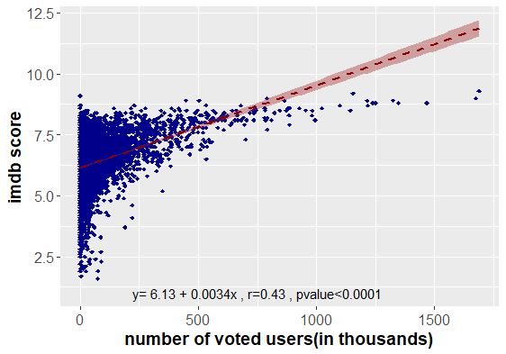
Min. 1st Qu. Median Mean 3rd Qu. Max.
6 9511 35990 85569 98351 1689764
dim(filter(movie,num_voted_users>231611))[1]
[1] 429
Min | 6
1st Qu. | 9511
Median | 35990
Mean | 85569
3rd Qu. | 98351
Max | 1689764

Slide 4
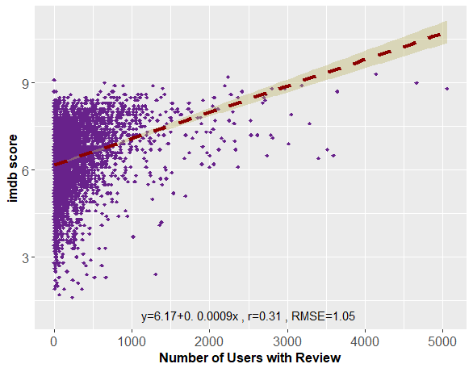
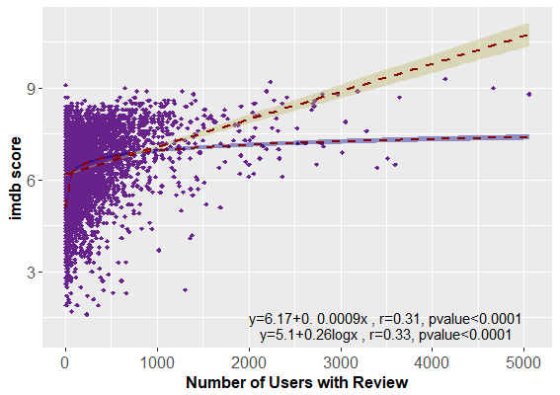
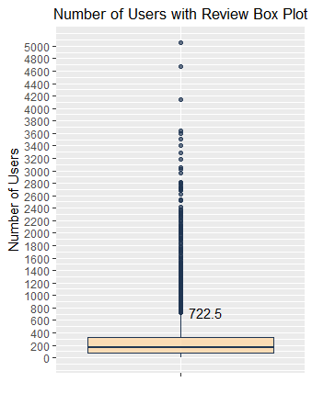
dim(filter(movie,num_user_for_reviews>=722.5))[1]
[1] 354
Min. 1st Qu. Median Mean 3rd Qu. Max. NA's
1.0 70.0 161.5 277.3 331.0 5060.0 11
Min | 6
1st Qu. | 1
Median | 35990
Mean | 85569
3rd Qu. | 98351
Max | 1689764

Slide 5
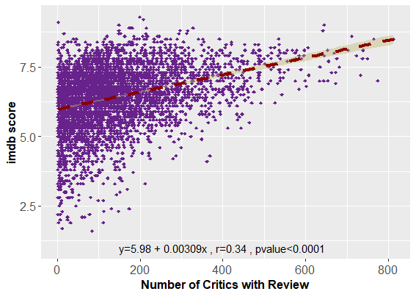
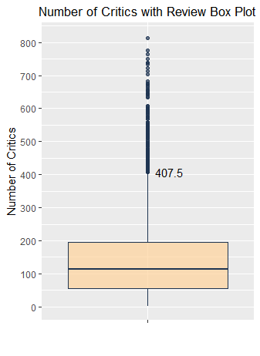
Min. 1st Qu. Median Mean 3rd Qu. Max. NA's
1 55 113 143 196 813 31
dim(filter(movie,num_critic_for_reviews>=407.5))[1]
[1] 192
Min | 6
1st Qu. | 9511
Median | 35990
Mean | 85569
3rd Qu. | 98351
Max | 1689764

Slide 6
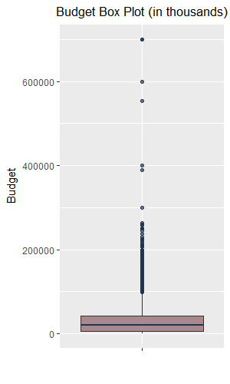
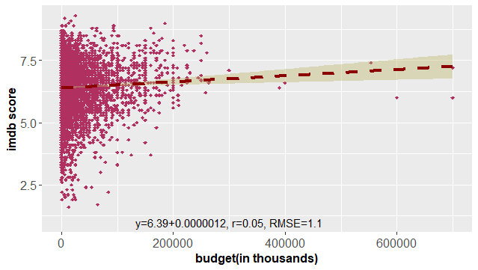
dim(filter(movie,budget>98500000))[1]
[1] 330
1 Tarnation
2 El Mariachi
3 Primer
4 Stan Helsing
5 My Date with Drew
6 Clean
7 Cavite
8 Newlyweds
9 Escape from Tomorrow
Budget<10000
Min. 1st Qu. Median Mean 3rd Qu. Max. NA's
218 6000000 20000000 34785275 44000000 2127519898 270
movie[which(budget<10000),c("title","budget")]
movie[which(title==" Escape from Tomorrow "),"budget"]<-650000
movie[which(title=="Stan Helsing"),"budget"]<-1000000
movie[which(budget/1000>300000),c("title","budget")]
europe<-c("The Messenger: The Story of Joan of Arc","Red Cliff","Kabhi Alvida Naa Kehna","Iceland","The Legend of Suriyothai","Kites","Tango")
movie[is.element(movie$title,europe),"budget"]<-c(85000000,553632000*0.16,700000000*0.016,400000000*0.032,600000000*0.016,700000000*0.0074)
write.csv(movie,"moviecut.csv")
movie[which(budget/1000>300000),"title"]
# A tibble: 6 x 1
title
<chr>
1 The Messenger: The Story of Joan of Arc
2 Red Cliff
3 Kabhi Alvida Naa Kehna
4 The Legend of Suriyothai
5 Kites
6 Tango

Slide 7
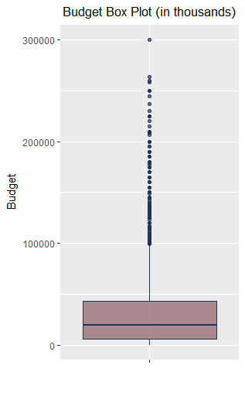
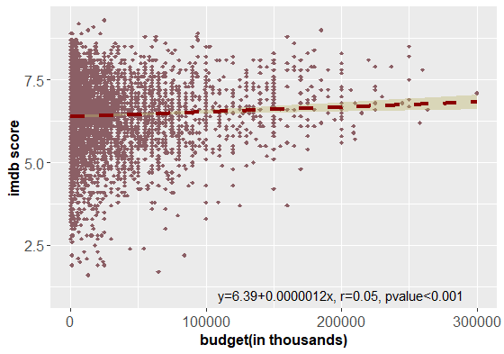
movie[which(budget/1000==300000),c("title","budget“,”imdb_score”)]
# A tibble: 1 x 2
title budget imdb_score
<chr> <dbl>
1 Pirates of the Caribbean: At World‘s End 300000000 7.1
Min. 1st Qu. Median Mean 3rd Qu. Max. NA's
218 6000000 19800000 32977537 43000000 300000000 270
dim(filter(movie,budget>98500000))[1]
[1] 324

Slide 8
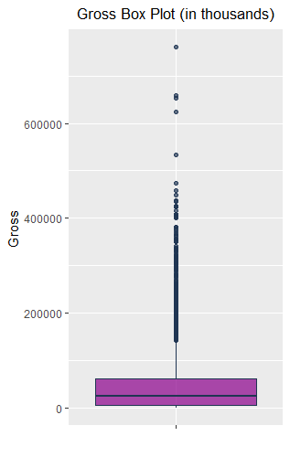
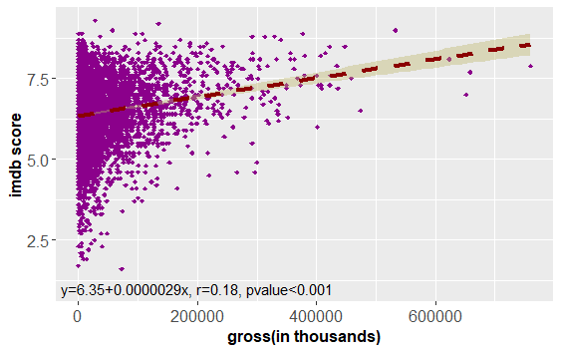
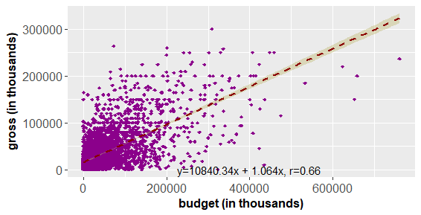
A tibble: 6 x 4
title gross release_date budget
<chr> <dbl> <chr> <dbl>
1 A Farewell to Arms 25.0 1932/12/8 800000
2 F.I.S.T. 11.0 1978/4/26 11000000
3 Out of the Blue 728 1980/5/1 NA
4 In Her Line of Fire 721 2006/4/21 1000000
5 The Jimmy Show 703 2002/1/16 1500000
6 Skin Trade 162 2014/11/7 9000000
Gross<1000
Min. 1st Qu. Median Mean 3rd Qu. Max. NA's
11 5480488 24402706 46808389 60049282 760505847 465-467 (in thousands)
movie[which(title=="A Farewell to Arms"),"gross"]<-NA
movie[which(title=="F.I.S.T."),"gross"]<-2038920
movie[which(title=="Out of the Blue"),"gross"]<-NA
movie[which(title=="Skin Trade"),"gross"]<-1242
dim(filter(movie,gross>141902473))[1]
[1] 300

Slide 9
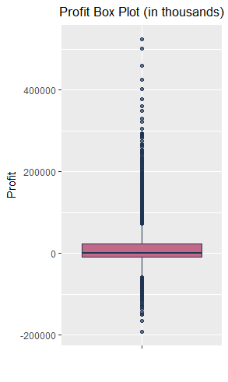
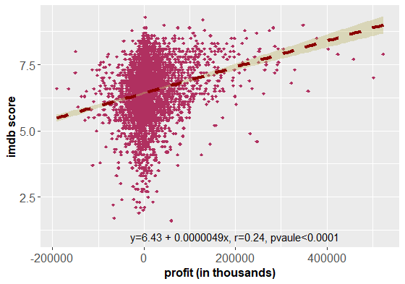
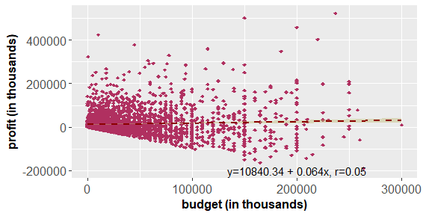
Min. 1st Qu. Median Mean 3rd Qu. Max. NA's
-190641321 -9264607 1496190 13122345 23691278 523505847 647
dim(filter(movie,profit>72962951))[1]
[1] 338
> dim(filter(movie,profit<(-58536280)))[1]
[1] 101

Slide 10
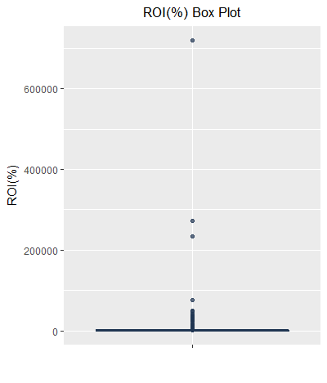
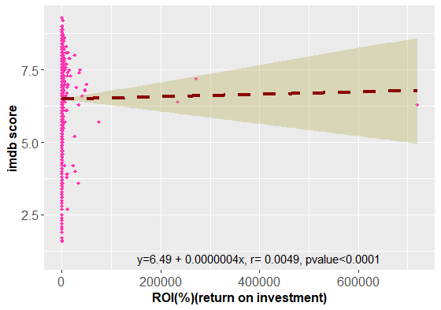
Min. 1st Qu. Median Mean 3rd Qu. Max. NA's
-100.0 -52.5 12.8 630.5 133.8 719348.6 647
dim(filter(movie,roe>410.26))[1]
404
dim(filter(movie,roe<(-332.3)))[1]
0
movie[which(roe>600000),c("title","genres", “imdb_score")]
# A tibble: 1 x 2
title genres
<chr> <chr>
1 Paranormal Activity Horror 6.3

Slide 11
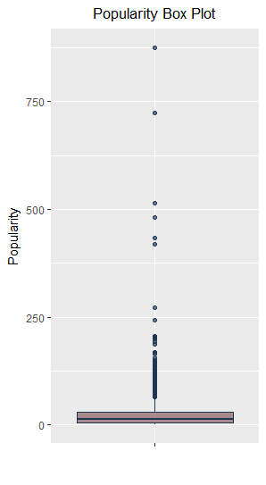
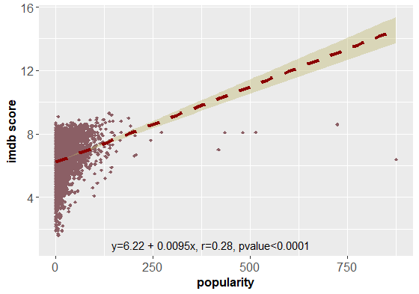
Min. 1st Qu. Median Mean 3rd Qu. Max.
0.000 4.912 13.472 21.888 28.812 875.581
dim(filter(movie,popularity>64.662))[1]
[1] 261

Slide 12
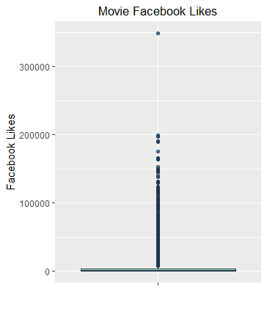
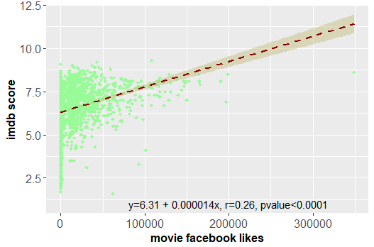
Min. 1st Qu. Median Mean 3rd Qu. Max.
0 0 168 7603 3000 349000
Adventure Drama Scifi
Intersteller:349000 likes imdb:8.6
length(which(movie_facebook_likes==0))
[1] 1994

Slide 13
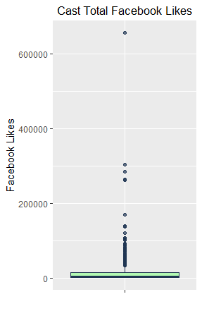
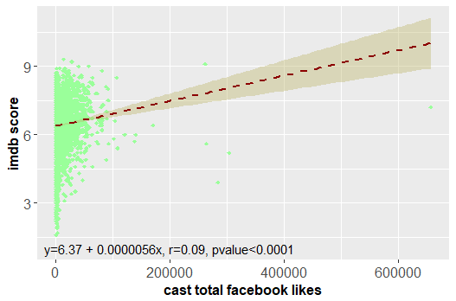
summary(cast_total_facebook_likes)
Min. 1st Qu. Median Mean 3rd Qu. Max.
0 1475 3163 9962 14166 656730
> length(which(cast_total_facebook_likes==0))
[1] 24
>600000 facebook likes:
Anchorman: The Legend of Ron Burgundy Comedy 7.2

Slide 14
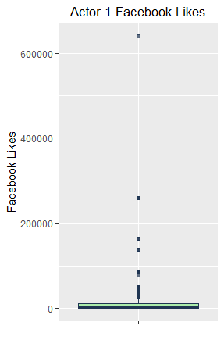
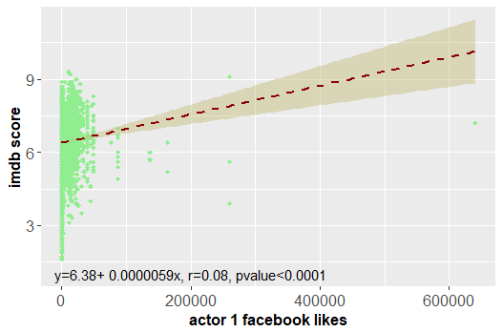
summary(actor_1_facebook_likes)
Min. 1st Qu. Median Mean 3rd Qu. Max. NA's
0 631 1000 6772 11000 640000 3
movie[which(actor_1_facebook_likes>600000),"actor_1_name"]
# A tibble: 1 x 1
actor_1_name
<chr>
1 Darcy Donavan 7.2
(有演Anchorman: The Legend of Ron Burgundy )

Slide 15
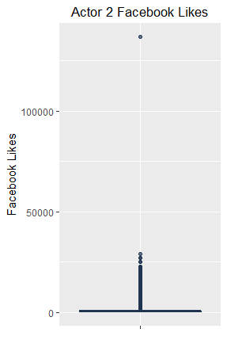
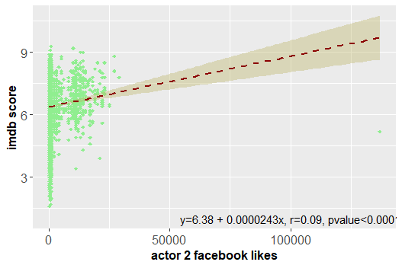
movie[which(actor_2_facebook_likes>100000),c("actor_2_name“,”title”,”imdb_score”]
# A tibble: 1 x 1
actor_2_name
<chr>
1 Andrew Fiscella The Final Destination 7.2
summary(actor_2_facebook_likes)
Min. 1st Qu. Median Mean 3rd Qu. Max. NA's
0 294 606 1684 925 137000 6

Slide 16
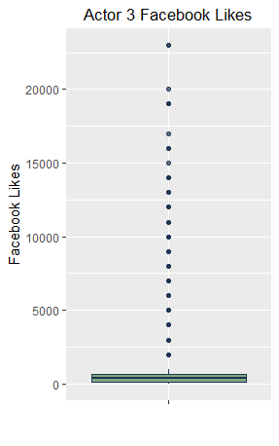
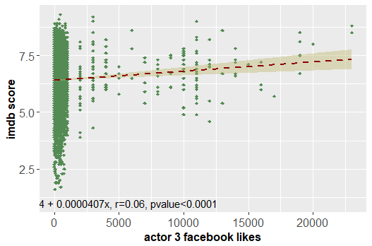
movie[which(actor_3_facebook_likes>20000),"actor_3_name"]
# A tibble: 2 x 1
actor_3_name
<chr>
1 Joseph Gordon-Levitt Inception 8.8
2 Joseph Gordon-Levitt The Dark Knight Rises 8.5
Min. 1st Qu. Median Mean 3rd Qu. Max. NA's
0 141 379 646 640 23000 12

Slide 17
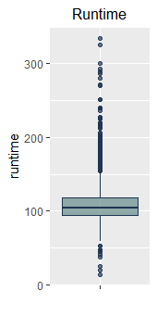
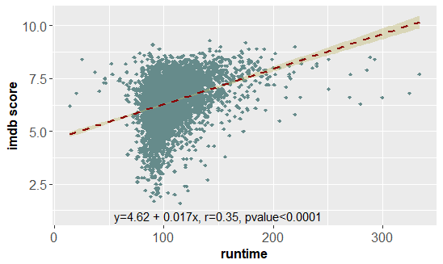
movie[which(runtime<30),"title"]
# A tibble: 3 x 1
title
<chr>
1 A Charlie Brown Christmas 8.4
2 Wal-Mart: The High Cost of Low Price 6.8
3 Vessel 6.2

Slide 18
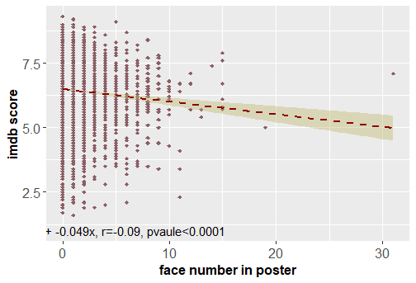

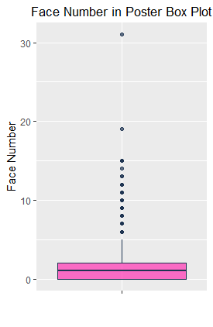

summary(facenumber_in_poster)
Min. 1st Qu. Median Mean 3rd Qu. Max. NA's
0.000 0.000 1.000 1.374 2.000 31.000 11
le genres imdb_score
<chr> <chr> <dbl>
1 The Master Drama 7.10
2 Battle of the Year Drama|Music 5.00

Slide 19
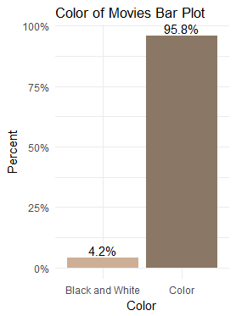
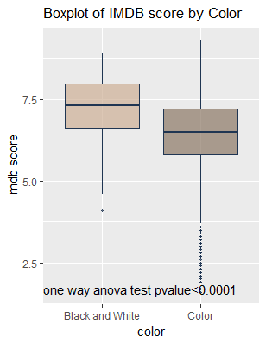
Black and White Color NA's
191 4364 12

Slide 20
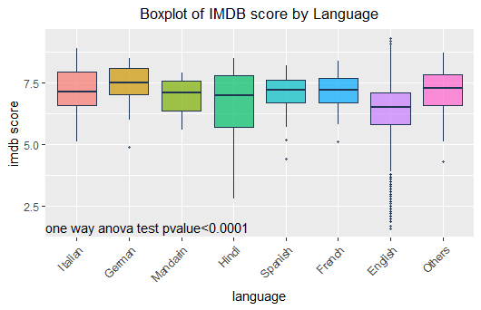
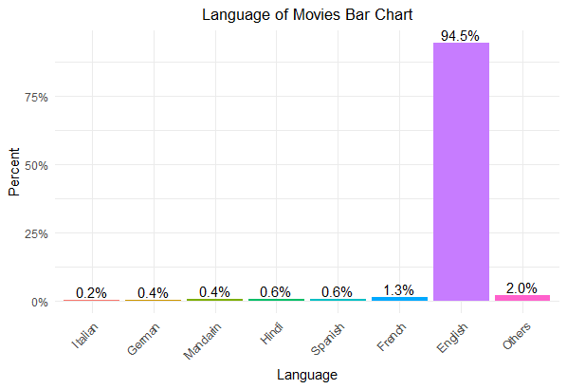
Italian German Mandarin Hindi Spanish French English Others
10 16 18 27 29 58 4317 92
Aboriginal Arabic Aramaic Bosnian Cantonese Chinese
2 4 1 1 9 3
Czech Danish Dari Dutch English Filipino
1 4 2 4 4317 1
French German Greek Hebrew Hindi Hungarian
58 16 1 5 27 1
Icelandic Indonesian Italian Japanese Kazakh Korean
1 1 10 8 1 4
Mandarin Maya Mongolian None Norwegian Persian
18 1 1 2 3 4
Polish Portuguese Romanian Russian Spanish Swahili
1 7 2 6 29 1
Swedish Tamil Telugu Thai Urdu Vietnamese
3 1 1 1 1 1
Zulu
2

Slide 21
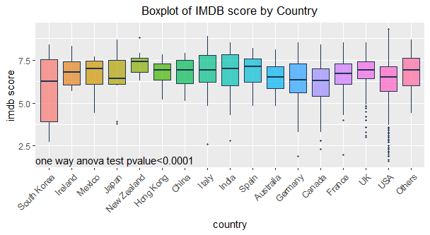
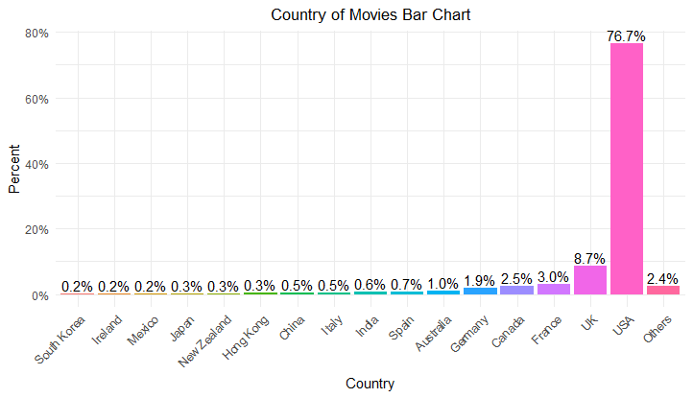
Afghanistan Argentina Aruba Australia Bahamas
1 4 1 47 1
Belgium Brazil Bulgaria Cambodia Cameroon
3 節 1 1
Canada Chile China Colombia Czech Republic
113 1 22 1 3
Denmark Egypt Finland France Georgia
9 1 1 137 1
Germany Greece Hong Kong Hungary Iceland
88 2 14 2 2
India Iran Ireland Israel Italy
29 4 11 4 22
Japan Kenya Kyrgyzstan Libya Mexico
13 1 1 1 11
Netherlands New Line New Zealand Nigeria Norway
5 1 13 1 6
Official site Pakistan Panama Peru Philippines
1 1 1 1 1
Poland Romania Russia Slovakia South Africa
2 4 7 1 8
South Korea Soviet Union Spain Sweden Switzerland
10 1 30 3 3
Taiwan Thailand Turkey UK USA
1 3 1 396 3502
West Germany
3
South Korea Ireland Mexico Japan New Zealand Hong Kong
10 11 11 13 13 14
China Italy India Spain Australia Germany
22 22 29 30 47 88
Canada France UK USA Others
113 137 396 3502 109

Slide 22
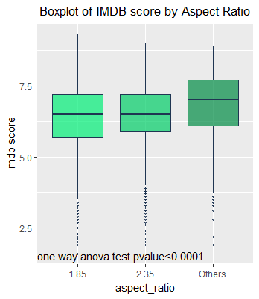
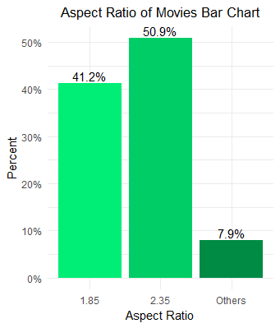
1.18 1.2 1.33 1.37 1.44 1.5 1.66 1.75 1.77 1.78 1.85 2 2.2 2.24 2.35
1 1 38 95 1 2 59 3 1 88 1774 4 14 1 2189
2.39 2.4 2.55 2.76 16 NA's
15 3 2 3 10 263

Slide 23
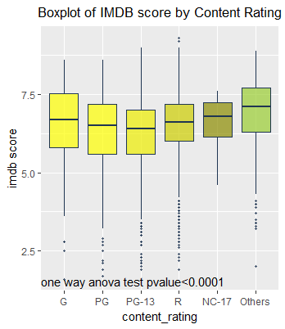
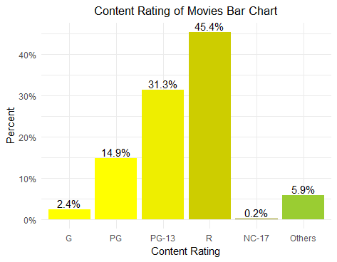
Approved G GP M NC-17 Not Rated Passed
52 104 6 4 7 106 9
PG PG-13 R TV-14 TV-G TV-PG Unrated
650 1366 1980 4 5 3 56
X NA's
11 204
G NC-17 Others PG PG-13 R
104 7 256 650 1366 1980

Slide 24
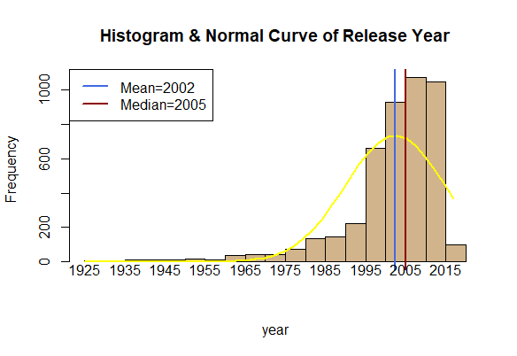



1920 1930 1940 1950 1960 1970 1980 1990 2000 2010
4 14 25 27 68 104 269 748 1946 1362

Slide 25


Jan Feb Mar Apr May Jun Jul Aug Sep Oct Nov Dec
358 310 354 334 352 371 343 394 562 447 306 436

Slide 26



Short News Film-Noir Western Documentary Musical
1 3 6 90 107 125
Sport History War Music Animation Biography
170 188 194 198 211 278
Mystery Family Horror Fantasy Sci-Fi Crime
445 487 497 535 549 805
Adventure Romance Action Thriller Comedy Drama
831 1027 1042 1291 1717 2361

Slide 27


Film-Noir History Romance Musical Family Western
1 1 2 4 10 11
Sci-Fi Thriller Mystery Fantasy Animation Documentary
13 19 31 45 52 73
Horror Biography Crime Adventure Drama Action
205 239 306 413 883 1042
Comedy
1217

Slide 28



mean(seq11$value)
[1] 6.81194
> mean(seq12$value)
[1] 6.098507
> sd(seq11$value)
[1] 0.853606
> sd(seq12$value)
[1] 1.007922
#Friday the 13th
trend6<-c(6.1,5.7,5.9,4.7,5.3,4.5)
#Terminator
trend5<-c(8.1,8.5,6.4,6.6,6.6)
#Scary Movie
trend4<-c(5.2,5.5,5.1,3.5)
#1-2:67
#1-3:16
#2-3:21
mean(seq31$value)
[1] 7.375
> mean(seq33$value)
[1] 6.06875
> median(seq31$value)
[1] 7.45
> median(seq33$value)
[1] 6.1
> sd(seq31$value)
[1] 0.6371813
> sd(seq33$value)
[1] 1.170595
#Friday the 13th
trend6<-c(6.1,5.7,5.9,4.7,5.3,4.5)
#Terminator
trend5<-c(8.1,8.5,6.4,6.6,6.6)
#Scary Movie
trend4<-c(5.2,5.5,5.1,3.5)
mean(seq22$value)
[1] 6.57619
> mean(seq23$value)
[1] 5.961905
> sd(seq22$value)
[1] 0.909343
> sd(seq23$value)
[1] 1.054266
> median(seq23$value)
[1] 6.1
> median(seq22$value)
[1] 6.6

Slide 29


Slide 30


dim(movie[movie$imdb_score>8,])[1]
[1] 206
> dim(movie[movie$imdb_score>7,])[1]
[1] 1387
> dim(movie[movie$imdb_score>5,])[1]
[1] 4092
> dim(movie[movie$imdb_score>6,])[1]
[1] 3120
> dim(movie[movie$imdb_score>5.5,])[1]
[1] 3702
> dim(movie[movie$imdb_score>7.5,])[1]
[1] 639

Slide 31



Slide 32



Slide 33



Slide 34



Slide 35



Slide 36



Slide 37



